Slide 1



UNIT 3: School
School subjects

Slide 2
How many school subjects have you got today?
How many school subjects have you got in total?
How many can you name in English?

Slide 3
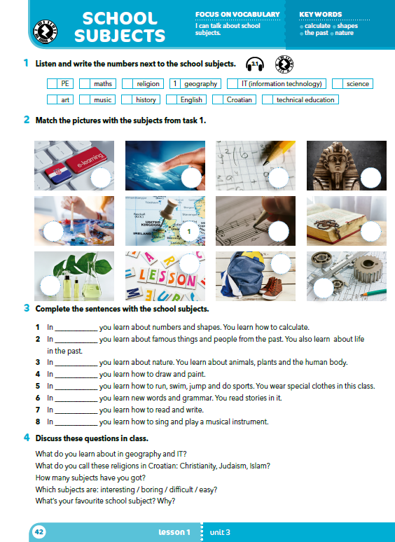
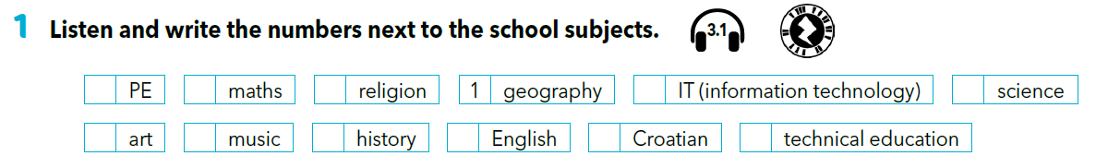

Listen and write the numbers next to the school subjects.
2
3
11
5
6
7
4
9
8
10
12
https://www.e-sfera.hr/dodatni-digitalni-sadrzaji/86ab528e-cf96-4a72-975d-a2096b711d2e/

Slide 4
Translate
PE – music –
maths – history –
religion – English –
geography – Croatian –
IT (information technology) – art –
technical education – science –
tjelesna i zdravstvena kultura
glazbena kultura
matematika
povijest
vjeronauk
engleski jezik
geografija
hrvatski jezik
informatika
likovna kultura
tehnička kultura
Priroda (*znanost)

Slide 5
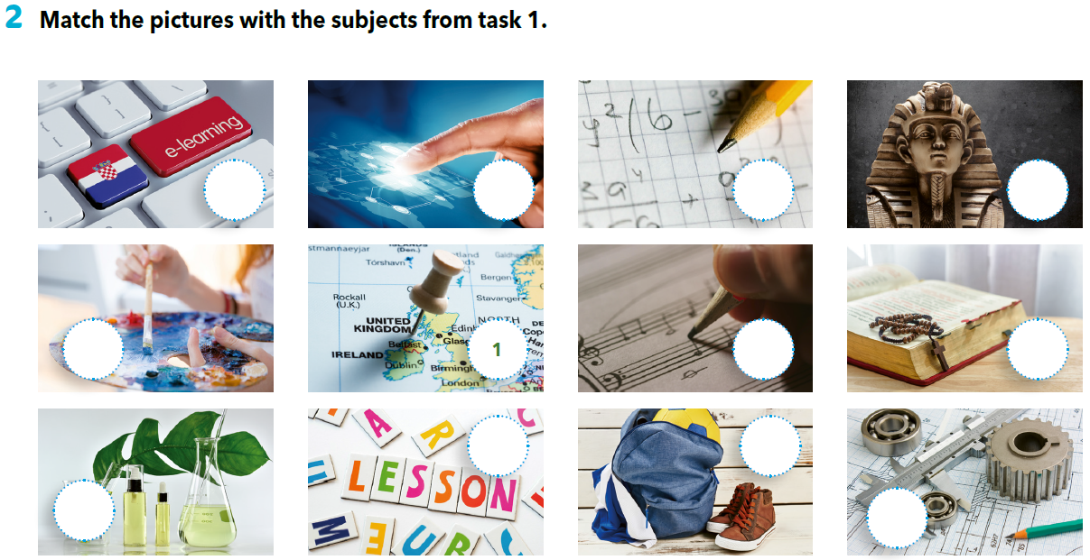
10
5
3
9
7
4
11
8
2
6
12

Slide 6
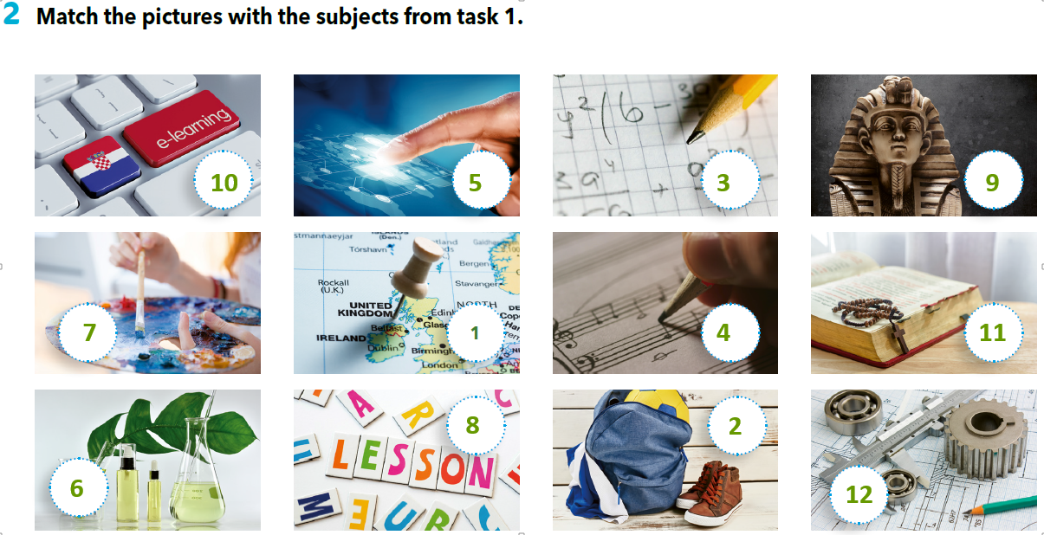
What do you learn in these subjects?
Can you name any of the things you learn about?

Slide 7
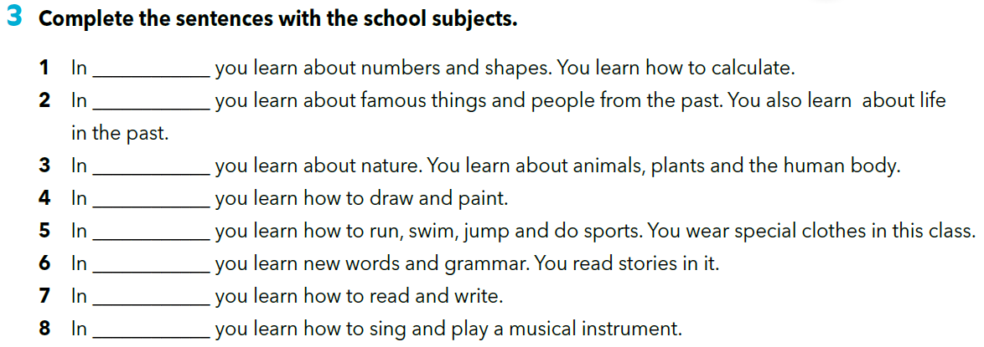
Fill in the gaps with the correct word (school subject).
maths
history
science
art
PE
English
Croatian
music

Slide 8
Choose one subject and introduce yourself as if you were a school subject. Look at the example.
Example:
I’m Music. My teacher is Ms Horvat.
When you learn about me, you learn how to
sing and play musical instruments.
Now it’s your turn!

Slide 9
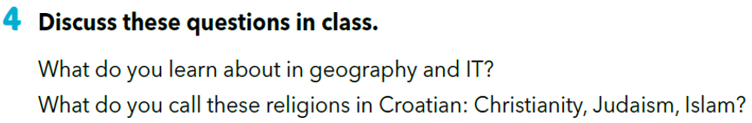
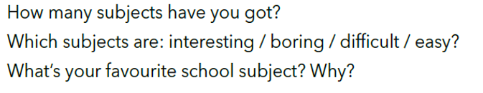
Answer the questions from task 4.
Koji predmeti su: zanimljivi / dosadni/ teško/ lagani?

Slide 10
LET’S REVISE!
Click on the following link and revise the new vocabulary.
https://wordwall.net/embed/07834e2efa8d4ebd946aef35b5195a4d?themeId=0&templateId=46
https://wordwall.net/embed/373472ace95c4605a2229e2ddc2bb9aa?themeId=0&templateId=23
https://wordwall.net/embed/704a87ace646437c9d5f659cdb7420aa?themeId=0&templateId=3

Slide 11
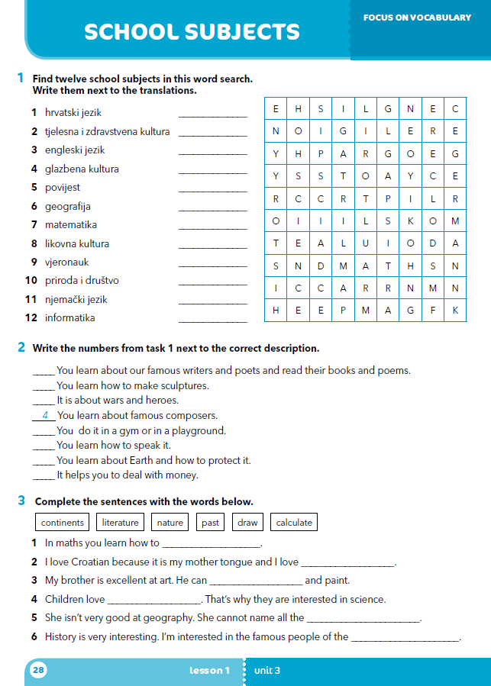
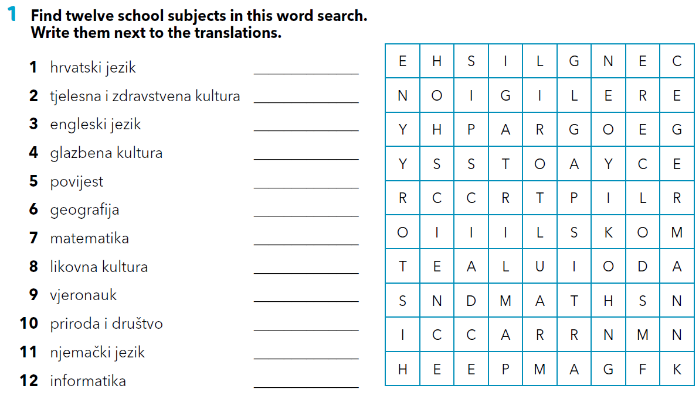
Open your workbook at page 28.
Croatian
PE
English
music
history
geography
maths
art
religion
science
German
IT

Slide 12
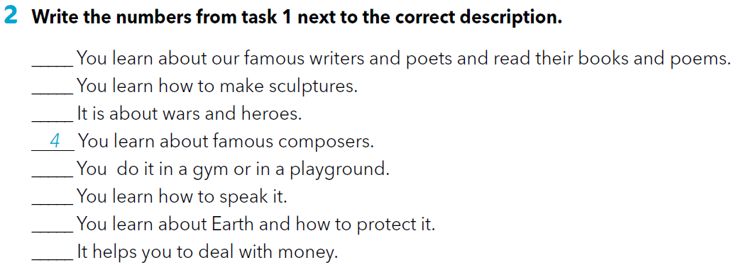
1
8
5
2
3
6
7

Slide 13
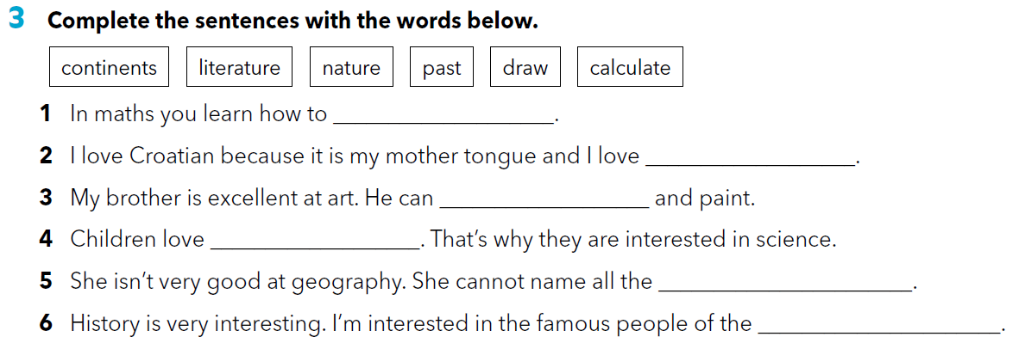
calculate
literature
draw
nature
continents
past

Slide 14
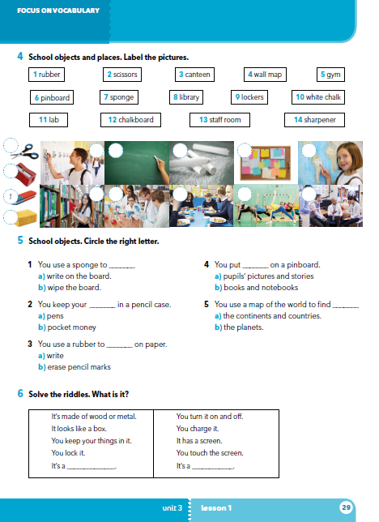
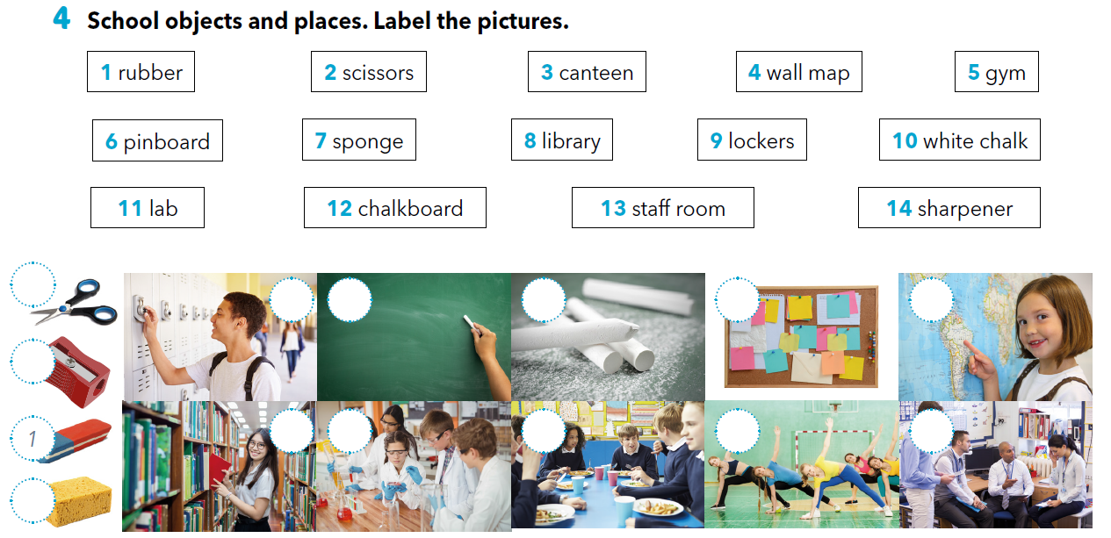
workbook p 29.
2
6
9
12
10
4
14
8
11
3
5
13
7

Slide 15
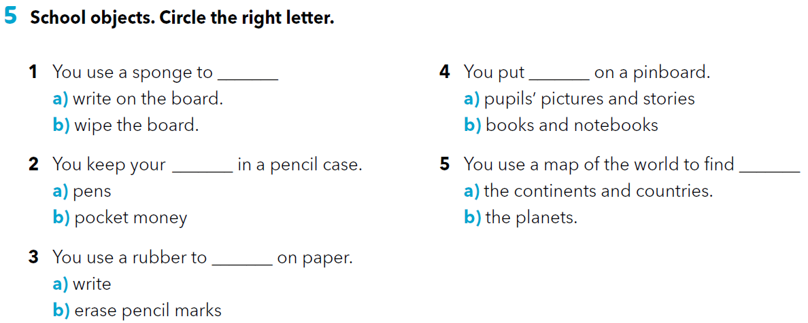

Slide 16
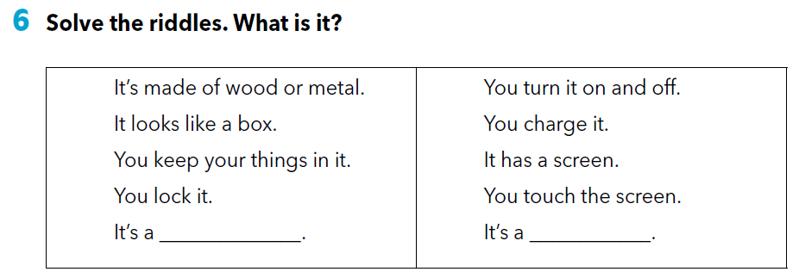
locker
smartphone

Slide 17

LEARN MORE
https://www.e-sfera.hr/dodatni-digitalni-sadrzaji/86ab528e-cf96-4a72-975d-a2096b711d2e/
Sudbury Valley school
Read the text and answer the questions.

Slide 18
SELF CHECK
https://www.e-sfera.hr/dodatni-digitalni-sadrzaji/86ab528e-cf96-4a72-975d-a2096b711d2e/

